Slide 1
The Modular Structure of Complex Systems

Slide 2
Overview
A Recap
Complex Systems
Module Guide
Modular Hierarchy
An Example – Linux Internals
Design Through Documentation
Conclusion

Slide 3
Modules
What is a Module?
  A Work Assignment
The Principles:
  Each module’s implementation is a secret
  Each module’s interface abstractly and precisely described
  We abstract from implementation details likely to change
  We parameterize changeable aspects that cannot be hidden

Slide 4
Contd…
Hierarchical Structure - directed graph with no loops
Encapsulation - language facility
Information Hiding - design principle

Slide 5
Some possible classification criteria for modules...
Similarity of interface
Ultimate purpose
Type of function or service provided
Similar programming problems
Nature of secret

Slide 6

Goals of Modular Structure
Modules can be designed independently
Modules can be tested independently
Modules can be changed independently
Integration goes on smoothly
Reduction of overall software cost!!!

Slide 7
A Complex System
Large number of interacting modules (usually greater than a couple hundred modules)
Collective behavior cannot be simply understood in terms of the behavior of modules

Slide 8
About Complex Systems ...
Many implementation decisions
Many details
How can we ……..
  keep the project under control ?
  keep the maintenance cost down?
  maintain conceptual integrity?
  avoid duplication?
  deal with unstructured lists of modules?

Slide 9

Quick example of a Complex System
The A-7E Aircraft
Extremely complex Onboard Flight Program
Limited memory
Real-time constraints

Slide 10

New Complications
Previous attempts dealt with simple systems i.e. less than 25 modules
Easy to find modules affected by changes in a design decision
What about complex systems with hundreds of modules???

Slide 11
New Complications
Impossible to carefully inspect each module
  Most maintainers ignorant about internal structure of most modules
Use of Information Hiding could backfire!
Any solutions?

Slide 12
Solution!
Create a hierarchically structured document - Module Guide

Slide 13

Module Guide
Shows how responsibilities are allocated among modules
Modular descriptions arranged according to hierarchical modular structure
Leads readers to a module that implements a certain aspect of the system

Slide 14
Being Specific….
Specifically, for each module the Module Guide states its :-
  Primary Secret
  Role
  Criteria behind assigning the module its particular responsibility

Slide 15
New terms…
Primary Secret: Hidden information contained within the module.
Secondary Secret: Implementation decisions used to implement the module.

Slide 16
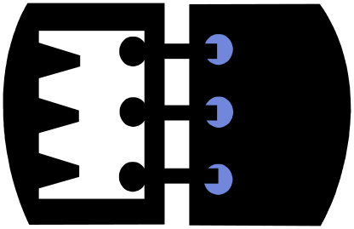
For example,
In an Address Book System, representation of an address is the primary secret of an Address Storage Module.
The data structures used to represent the address is the secondary secret of the Address Storage Module

Slide 17

How does the Module Guide help?
Hierarchical arrangement of modules allows current and future programmers to quickly read about relevant modules without searching through unrelated documentation.

Slide 18
How does the Module Guide help?
New programmers can get a good grasp of the project structure by reading the Module Guide.
  Eliminates the need for meeting and talking with older programmers familiar with the project

Slide 19
How does the Module Guide help?
Aids design review
Helps developers assess the effects of potential changes (enables them to quickly locate modules that would need to be modified.)

Slide 20


How does the Module Guide help?
Saves Time
Saves Effort
Provides Development Support
Lowers maintenance costs for complex software systems!

Slide 21
Modular Hierarchy
Modules organized by the type of secret.
  First level – Hardware Hiding Modules, Behavior Hiding Module and Software Decision Module
Nodes represent modules.
An edge from node i to node j shows that node j is a sub-module of node i.

Slide 22
Modular Hierarchy
Top Level Decomposition
parent of
Second Level Decomposition
parent of
Third Level

Slide 23
Top level Decomposition
Hardware-Hiding Module: Programs that need to be changed if any part of the hardware is replaced.
Behavior-Hiding Module: Programs that need to be changed if there are changes in the required behavior.
Software Decision Module: Hides software design decisions that are based on mathematical theorems, physical facts, and programming considerations.

Slide 24

Top level Decomposition
The three first-level modules could be used for the top-level design of ninety percent of software systems

Slide 25
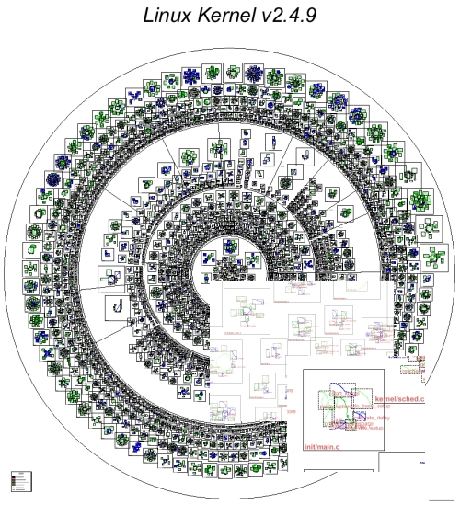
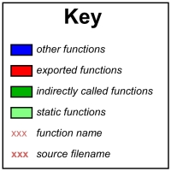
An Example: Linux Internals

Slide 26
Linux: Second-level Decomposition
Hardware-Hiding Module
  Drivers - contains modules that pertain to the kernels device drivers
  Architecture - modules that contain hardware architecture specific kernel code

Slide 27
Linux: Second-level Decomposition
Behavior-Hiding Module
  IPC - contains modules that perform inter-process communication
  init - contains modules that perform initialization

Slide 28
Linux: Second-level Decomposition
Software Decision Module
  FS - contains modules that interface with many different file systems
  MM - contains modules that control memory management

Slide 29
Linux Internals – Uses Structure
Linux Kernel
Drivers
File System
Memory
Manager
Network
Hardware
Architecture
Interprocess
Comm
...
...
...
...
ext2
vfat
xfs
sparq
i386
alpha

Slide 30
Module Guide: Drivers
Drivers:
Takes care of the interface and implementation between user programs, the kernel and peripherals. This module hides how external / internal hardware etc… is interfaced.
The modules included here are specific to how hardware is used.
Role
Primary secret
Criteria

Slide 31
Restricted & Hidden Modules
Restricted Modules: modules that contain information which cannot be hidden in a single module practically.
Hidden Modules: “sub-modules” contained in larger modules that clearly specify where certain functions are performed.

Slide 32
Linux Internals – Restricted & Hidden Modules
Linux Kernel
Drivers
File System
R
Memory
Manager
Network
Hardware
Architecture
Interprocess
Comm
...
...
...
...
ext2
vfat
xfs
sparq
i386
alpha
H
journaling

Slide 33

Parnas’ Experience
“When we tried to work without the guide, ……responsibilities ended up either in two modules or in none. With the module guide, further progress on the design has revealed relatively few oversights”.

Slide 34
Parnas’ Experience
Integration testing took only a week
Only nine bugs were discovered.
Location of bugs isolated to single module.
All bugs were quickly fixed.

Slide 35
“Design Through Documentation”
Module Guide: Helps developers and maintainers of the system find modules affected by a change
Module Interface Document : Contains precise and complete description of interface to each module

Slide 36
“Design Through Documentation”
Module Design Document : An internal design document for each implementation of a module
Requirements Document : Module Guide refers to it for the related changes

Slide 37
Tying it all together
Complex Systems are too complex – too many modules!
Well-structured Module Guide needed to provide development support and to cut down maintenance costs.
“Design through Documentation” increases likelihood of product completeness and software reusability.

Slide 38

The End

